Slide 1
System Center, PowerShell and 802.1X NAC
Connecting the dots for easy device integration
Christian Lehrer @chri_tea

Slide 2
Agenda
802.1X
Overview
Benefits
Shortcomings
MAC-Bypass
Automated device registration
Demo
Process description

Slide 3
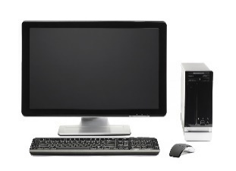
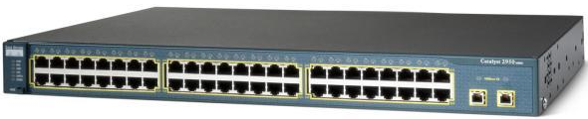

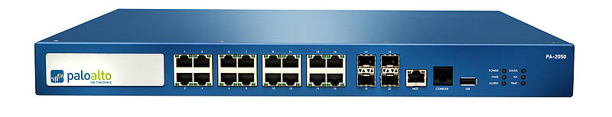
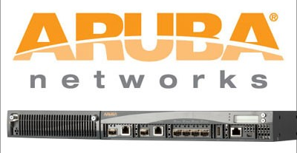

IEEE* 802.1X – Overview
Supplicant
Authenticator
Company network
1.
4.
with Computer
Certificate
2.
3.
Authentication Server
RADIUS
* Institute of Electrical and Electronics Engineers
Notes:
IEEE Standard for port-based Network Access Control. Das Institute of Electrical and Electronics Engineers
Often implemented in Wireless LANs
Good for Domain-Environments with existing PKI

Slide 4
Benefits of 802.1X
The VLAN is based on supplicant – the RADIUS defines the VLAN for the port while supplicant is connected
Knowledge – Which devices are connected to the company network and where
Secure network ports in meeting rooms etc.

Slide 5
Shortcomings of 802.1X Cert-based
Devices that can not handle certificates can not be authenticated.
Old devices
Line of business devices
Mulifunction printers
IP-phones

Slide 6
802.1X MAC-Bypass
For those devices the „MAC-Bypass“ implementation can be used.
A known device can be registered with MAC-adress in the RADIUS and thus be authenticated.
Contra MAC-Bypass:
busy hepldesk and thus slow process for users

Slide 7
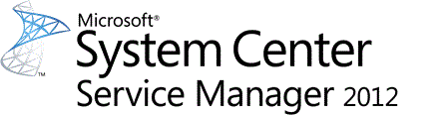



802.1X automated device registration
End User Self service portal
Orchestrator & PowerShell
ARUBA Clearpass API
Automated device registration
+
+
=

Slide 8
Demo
$Audience = Get-Audience
If ($Audience.status –eq ‘nearly asleep‘) {
Set-Audience –Status awake –Force }

Slide 9
# Video Self Service Portal ServiceManager.mp4
# Video Orchestrator Orchestrator_reviewed.mp4
# PowerShell script to create XML CreateNACDevices.xml
# Video ARUBA Clearpass Aruba_reviewed.mp4

Slide 10
Summary
802.1X can be implemented in a way users can accept it.
User self service portals are important for your automation success.
APIs are your friends.

Slide 11
Next Steps...
Now: 15 min break
Grab a coffee
Stay here to enjoy next presentation
Change track and switch to another room
Ask me questions or meet me in a breakout session room afterwards

Slide 12
Questions?

Slide 13
About_Author
Christian Lehrer
System Architect at Diehl Controls
Twitter.com/chri_tea
www.christianlehrer.com
PowerShell Usergroup Southern Germany
www.powershell-ug.com

